Slide 1
Recursive Language & Recursively Enumerable Language
Prof. Ritesh Upadhyay
Assistant Professor, Dept. of Computer Engineering.
UVPCE, Ganpat University

Slide 2
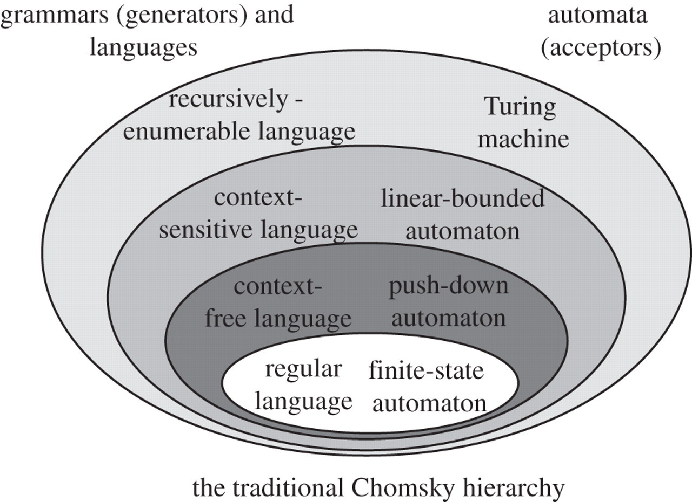
Chomsky’s classification of Formal Language

Slide 3
Recursive Language(REC): If the strings of language are producing by Turing machine effectively enumerated in, alphabetically or canonical order(Dictionary order) then the language is known as Recursive Language.
OR
Recursive Language(REC): By Reading every string of ‘x’ of language , then TM halts .
if it’s halts in final state then string is Accepted and if it’s halts into non-final state then string is Rejected, so such kind of language is Recursive Language.

Slide 4
Recursively Enumerable Language (R.E.): If the strings of language are producing by Turing machine effectively enumerated in, alphabetically or canonical order(Dictionary order) or any order then the language is known as Recursively Enumerable Language.
OR
Recursively Enumerable Language(R.E): By Reading every string of ‘x’ of language , then TM halts or for every string of language TM may halts or may not halts and entering to infinite loop, so such kind of language is Recursively Language.

Slide 5
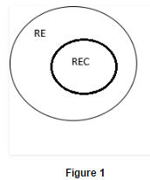
According to definition its clear that all Recursive language is the subset of Recursively Enumerable language.

Slide 6
Closure Properties of Recursive Languages
Union: If L1 and If L2 are two recursive languages, their union L1∪L2 will also be recursive because if TM halts for L1 and halts for L2, it will also halt for L1∪L2.
Concatenation: If L1 and If L2 are two recursive languages, their concatenation L1.L2 will also be recursive. For Example:
L1= {a^{n}b^{n}c^{n}|n>=0}
L2= {d^{m}e^{m}f^{m}|m>=0}
L3= L1.L2 = {a^{n}b^{n}c^{n}d^{m} e^{m}f^{m}|m>=0 and n>=0} is also recursive.

Slide 7
Kleene Closure: If L1is recursive, its kleene closure L1* will also be recursive. For Example:
L1= {a^{n}b^{n}c^{n}|n>=0}
L1*= { a^{n}b^{n}c^{n}||n>=0}* is also recursive.
Intersection and complement: If L1 and If L2 are two recursive languages, their intersection
L1 ∩ L2 will also be recursive.
For Example: L1= {a^{n}b^{n}c^{n}dm|n>=0 and m>=0} L2= {a^{n}b^{n}c^{n}d^{n}|n>=0 and m>=0}
L3=L1 ∩ L2 = { a^{n}b^{n}c^{n}d^{n} |n>=0} will be recursive.

Slide 8
Closure Properties of Recursively Enumerable Languages
Union: If L1 and If L2 are two recursively enumerable languages, their union L1∪L2 will also be recursively enumerable language.
Recursively enumerable languages are closed under concatenation and Intersection.
But Recursively enumerable languages are not closed under compliment and Kleene clouser.

Slide 9
Decidability and Un-decidability
Decidability : For any Language or problem, if there exist Halting Turing machine then the problem is said to decidable.
Un-decidability : For any Language or problem, if there exist No Halting Turing machine then the problem is said to un- decidable.
Example of Un-decidable problems
Halting problem of a Turing machine
Post correspondent Problem

Slide 10
L = { Odd length palindrome string over input (a,b) }
OR
L = { WXW^{R} | X € (a,b) W € (a,b)* }
Example: aba, bab, aaa,bbb, aaaaaaa, abbabba

Slide 11
